Slide 1
.NET Framework Collection Types
Lecturer: Ngo Huy Bien
Software Engineering Department
Faculty of Information Technology
VNUHCM - University of Science
Ho Chi Minh City, Vietnam
nhbien@fit.hcmus.edu.vn

Slide 2

Objectives

Slide 3

References
Dan Clark. Beginning C# Object-Oriented Programming. Apress. 2013.
Joseph Albahari and Ben Albahari. C# 6.0 in a Nutshell. Sixth Edition. O’Reilly Media, Inc. 2016.

Slide 4
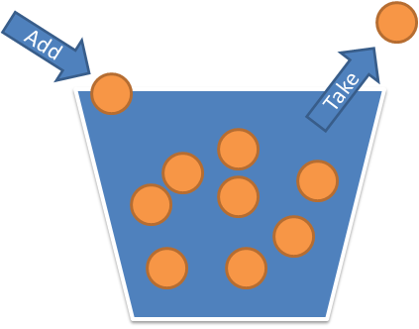
.NET Framework Collection Types [1]
Programmers frequently need to work with collections of types.
The .NET Framework provides a variety of basic and specialized collection classes for you to use.
The System.Collections namespace contains interfaces and classes that define various types of collections, such as lists, queues, hash tables, and dictionaries.
All collections need a basic set of functions, such as adding objects, removing objects, and iterating through their objects.
In addition to the basic set, some collections need additional specialized functions.

Slide 5
Array
An array holds data elements of the same data type.
int[] intArray = { 1, 2, 3, 4, 5 };
Console.WriteLine("Upper Bound");
Console.WriteLine(intArray.GetUpperBound(0));
Console.WriteLine("Array elements");
foreach (int item in intArray)
{
Console.WriteLine(item);
}
Array.Reverse(intArray);
Console.WriteLine("Array reversed");
foreach (int item in intArray)
{
Console.WriteLine(item);
}

Slide 6
Array List
The capacity of an array list automatically expands as required, with the memory reallocation and copying of elements performed automatically.
ArrayList nameList = new ArrayList();
nameList.Add("Bob");
nameList.Add("Dan");
nameList.Add("Wendy");
Console.WriteLine("Original Capacity");
Console.WriteLine(nameList.Capacity);
Console.WriteLine("Original Values");
foreach (object name in nameList)
{
Console.WriteLine(name);
}

Slide 7
Generic List
Generics let you define a class without specifying its type.
The type is specified when the class is instantiated.
List<Customer> customerList = new List<Customer>();
customerList.Add(new Customer
("WHITC", "White Clover Markets", "Karl Jablonski"));
customerList.Add(new Customer
("RANCH", "Rancho grande", "Sergio Gutiérrez"));
customerList.Add(new Customer
("ALFKI","Alfreds Futterkiste","Maria Anders"));
foreach (Customer c in customerList)
{
Console.WriteLine(“Id: {0} Company: {1} Contact: {2}”, c.CompanyId, c.CompanyName, c.ContactName);
}

Slide 8
IEnumerator<T> [2]
The IEnumerator interface defines the basic low-level protocol by which elements in a collection are traversed—or enumerated—in a forward-only manner.
Its declaration is as follows:
public interface IEnumerator {
bool MoveNext();
object Current { get; }
void Reset();
}
Generic version:
IEnumerator<T> : IEnumerator, IDisposable {
T Current { get; }
}
By defining a typed version of Current, the interface strengthen static type safety, avoid the overhead of boxing with value-type elements, and are more convenient to the consumer.

Slide 9
IEnumerable<T>
Collections do not usually implement enumerators; instead, they provide enumerators, via the interface IEnumerable:
public interface IEnumerable
{
IEnumerator GetEnumerator();
}
Generic version:
public interface IEnumerable<T> : IEnumerable
{
IEnumerator<T> GetEnumerator();
}

Slide 10

Example

Slide 11

yield return Statement

Slide 12
Implementing IEnumerable<T> [1]

Slide 13
ICollection<T>
Defines methods to manipulate generic collections.

Slide 14
IDictionary<TKey, TValue>
Represents a generic collection of key/value pairs.
Each element is a key/value pair stored in a KeyValuePair object.
Implementers: Dictionary<TKey, TValue> class.

Slide 15
IList<T>
Represents a collection of objects that can be individually accessed by index. Implementer: List<T> class.

Slide 16
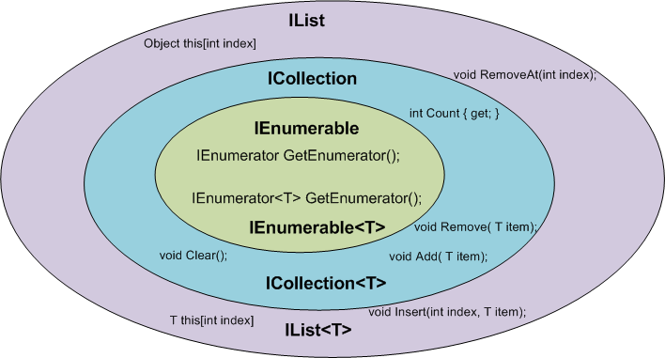
When to Use IEnumerable, Icollection and IList
ICollection, ICollection<T> : You want to modify the collection or you care about its size.
IList, IList<T>: You want to modify the collection and you care about the ordering
and / or positioning of the elements in the collection.

Slide 17
Covariance and Contravariance
Covariance – types of arguments in redefined method are subtypes of types of arguments in parent method.
Contravariance – types of arguments in parent’s method are subtypes of types of arguments in redefined method
https://en.wikipedia.org/wiki/Covariance_and_contravariance_%28computer_science%29
http://stackoverflow.com/questions/2184551/difference-between-covariance-contra-variance

Slide 18


Slide 19
Sequence [2]
A sequence is any object that implements IEnumerable<T> and an element is each item in the sequence.
string[] names = { "Tom", "Dick", "Harry" };
We call names a local sequence because it represents a local collection of objects in memory.

Slide 20
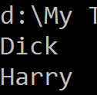
Query Operator
A query operator is a method that transforms a sequence.
A typical query operator accepts an input sequence and emits a transformed output sequence.
A query is an expression that, when enumerated, transforms sequences with query operators.

Slide 21
Standard Query Operator
In the Enumerable class in System.Linq, there are around 40 query operators—all implemented as static extension methods. These are called standard query operators.
Most query operators accept a lambda expression as an argument.

Slide 22
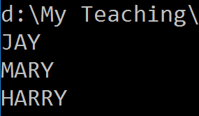
Chaining Query Operators
To build more complex queries, you append additional query operators to the expression, creating a chain.
The Select method emits a sequence where each input element is transformed or projected with a given lambda expression

Slide 23
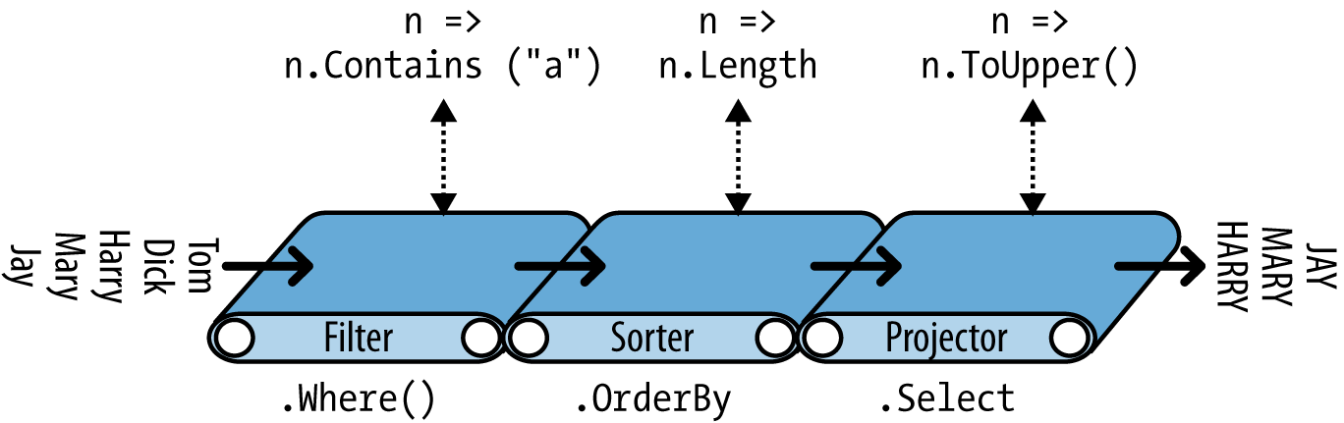
Chaining Operators’ Input And Output
When query operators are chained, the output sequence of one operator is the input sequence of the next.

Slide 24
Enumerable.Where Implementation
A lambda expression in a query operator always works on individual elements in the input sequence—not the sequence as a whole.
A lambda expression that takes a value and returns a bool is called a predicate.
public static IEnumerable<TSource> Where<TSource>
(this IEnumerable<TSource> source, Func<TSource,bool> predicate)
{
foreach (TSource element in source)
if (predicate (element))
yield return element;
}

Slide 25
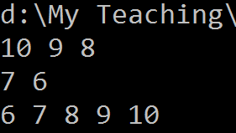
Natural Ordering

Slide 26
Query Expressions
C# provides a syntactic shortcut for writing LINQ queries, called query expressions.
Query expressions always start with a from clause and end with either a select or group clause.
The from clause declares a range variable (in this case, n), which you can think of as traversing the input sequence

Slide 27
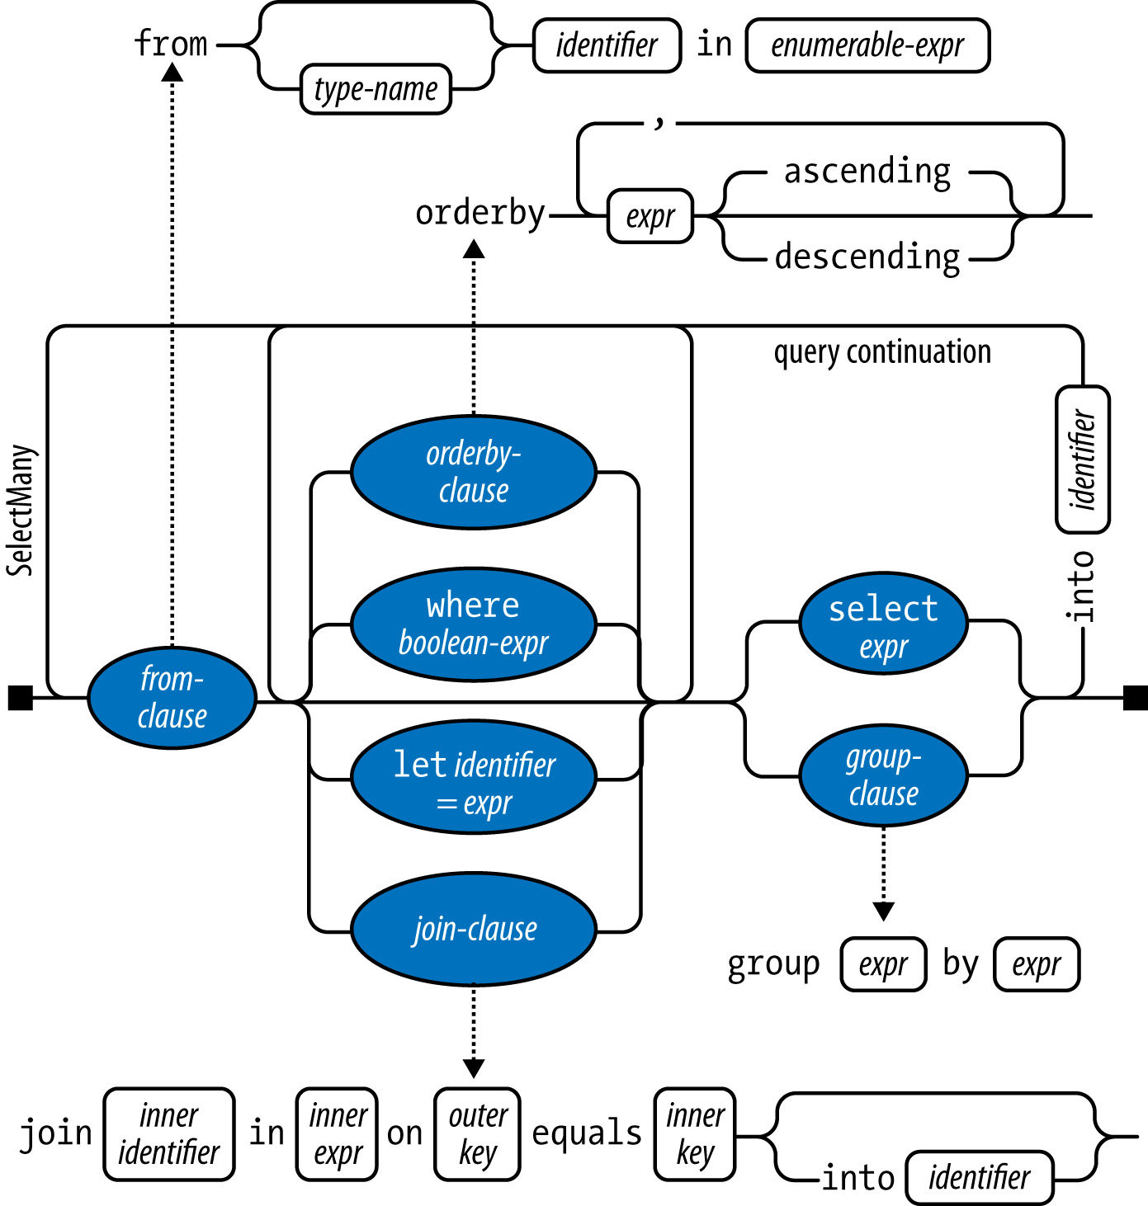
Railroad Diagram

Slide 28
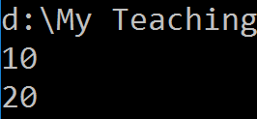
Deferred Execution
Most query operators (except operators that return a single element or scalar value, such as First or Count or conversion operators, such as ToArray, ToList, ToDictionary, ToLookup) execute not when constructed, but when enumerated (in other words, when MoveNext is called on its enumerator).
This is called deferred or lazy execution.

Slide 29
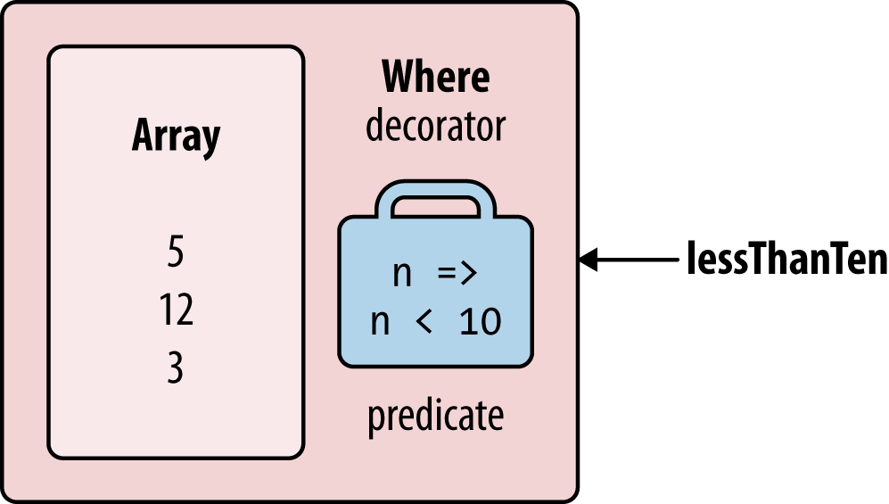
How Deferred Execution Works?
Query operators provide deferred execution by returning decorator sequences.
Unlike a traditional collection class, such as an array or linked list, a decorator sequence (in general) has no backing structure of its own to store elements.
Instead, it wraps another sequence that you supply at runtime, to which it maintains a permanent dependency.
IEnumerable<int> lessThanTen = new int[] { 5, 12, 3 }.Where (n => n < 10);

Slide 30
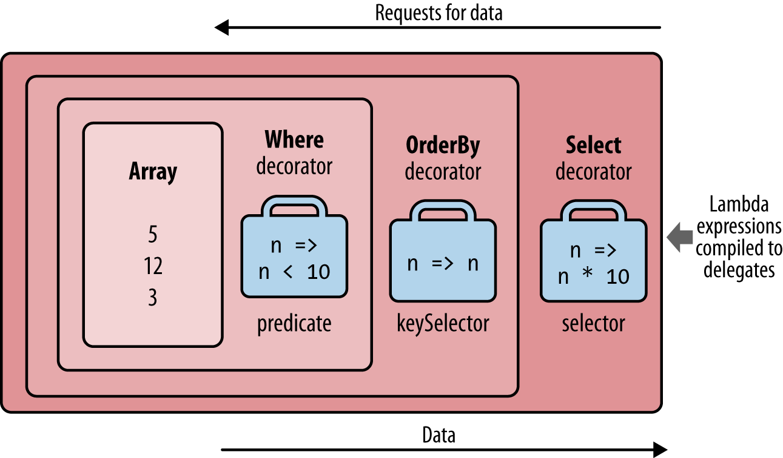
Chaining Decorators
Chaining query operators creates a layering of decorators.
IEnumerable<int> query = new int[] { 5, 12, 3 }
.Where (n => n < 10)
.OrderBy (n => n)
.Select (n => n * 10);
When you enumerate query, you’re querying the original array, transformed through a layering or chain of decorators.

Slide 31
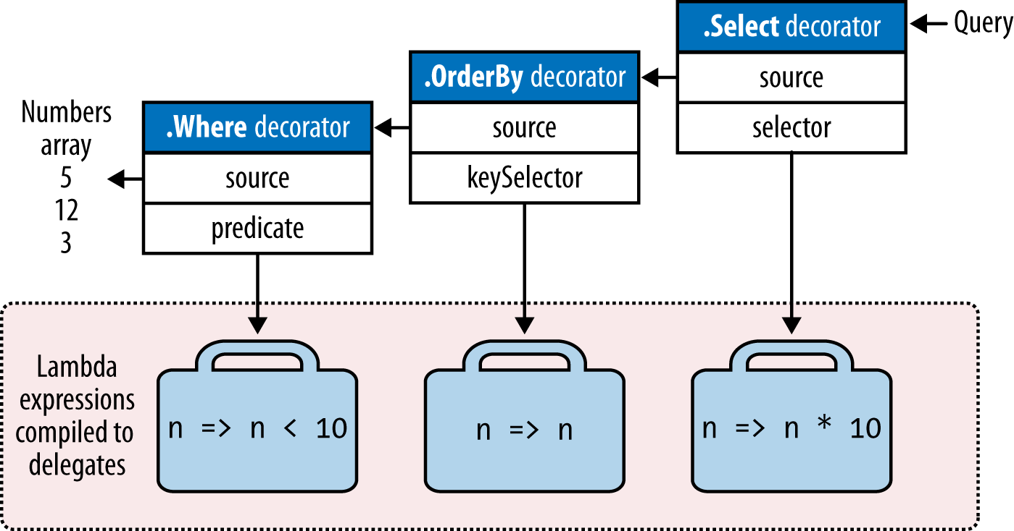
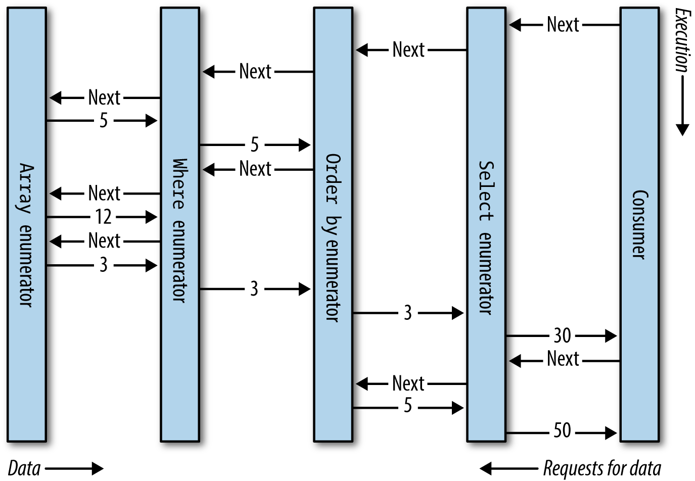
Execution Of A Local Query

Slide 32
Expression Trees

Slide 33
What is LINQ? [2]
LINQ, or Language Integrated Query, is a set of language and framework features for writing structured type-safe queries over local object collections and remote data sources.
A sequence is any object that implements IEnumerable<T> and an element is each item in the sequence.
string[] names = { "Tom", "Dick", "Harry" };
We call names a local sequence because it represents a local collection of objects in memory.

Slide 34
Query Operator
A query operator is a method that transforms a sequence.
A typical query operator accepts an input sequence and emits a transformed output sequence.
static void Main()
{
string[] names = { "Tom", "Dick", "Harry" };
IEnumerable<string> filteredNames =
names.Where (n => n.Length >= 4);
foreach (string name in filteredNames)
Console.WriteLine (name);
}

Slide 35

Thank You & See You Again

